Slide 1
Computer Graphics
Prepared By: Dipesh Gautam

Slide 2
Computer Graphics
Computer Graphics is the field of study that deals with generating, manipulating, and displaying visual content on digital devices. It involves converting data into visual form—images, animations, or interactive visualizations—through computational techniques.
Definition (Hearn & Baker): “Computer graphics is the art and science of creating, manipulating, and displaying images using computers.”

Slide 3
Applications of Computer Graphics
1.Computer-Aided Design (CAD)
2. Entertainment and Animation
3. Education and Training
4. Scientific Visualization
5. Graphical User Interfaces (GUI)
6. Image Processing and Computer Vision

Slide 4
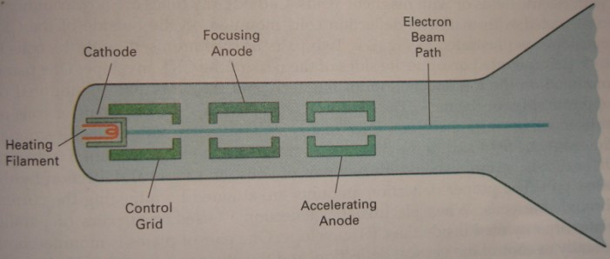
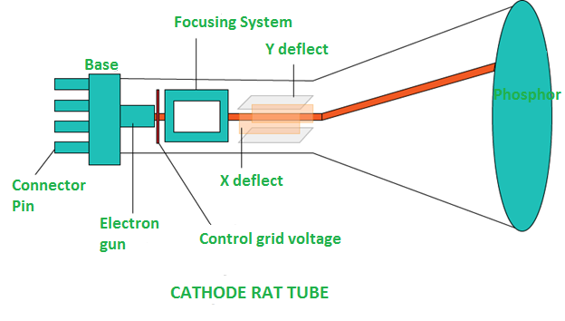
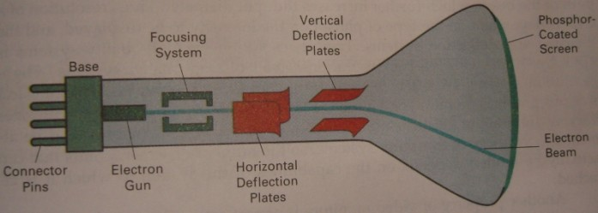
Video Display Devices
Cathode Ray Tube (CRT)
  Components:
    Electron Gun → composed of heated metal cathode and control grid
    Accelerating Anode
    Focusing System
    Deflection system
    Phosphor Screen
Prepared By: Dipesh Gautam

Slide 5
CRT Operation
Heat generated in cathode boils off the electrons
Electrons are accelerated towards phosphor screen with high positive voltage applied at accelerating anode
The negative voltage applied at cylindrical control grid controls the intensity of electron beam by repealing electrons
  High negative voltage stops electron passing from the hole of control grid while small negative voltage decreases electron passage
Focusing system concentrates electron beam to a small spot
  In electrostatic focusing, electrons pass through positively charged metal cylinder
  In magnetic focusing, coils are mounted outside of CRT Envelope which produces smallest spot
Deflection System deflects electron beam horizontally and vertically
  Magnetic→ two pairs of coils
  Electrostatic → two pairs of deflection plates
Refresh rate depends on persistence of phosphor
Prepared By: Dipesh Gautam

Slide 6
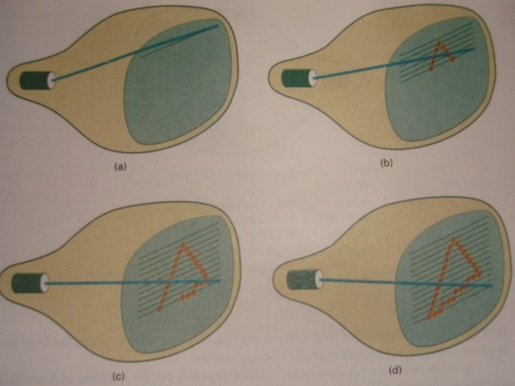
Raster Scan Displays
The electron beam is swept across the screen, one row at a time from top to bottom
The illuminated spot pattern is created by turning on or off when electron beam moves along each scan line
Picture definition is stored in a memory area called Refresh Buffer (Frame Buffer)
  Refresh Buffer holds the set of intensity values for all the screen points
  Each screen points is known as pixel (short form of picture element)
Example: Home television sets and printers
For bilevel system (black and white ) only 1 bit memory per pixel is sufficient
For color system more bits per pixel are needed
  For screen with resolution 1024 by 1024, and 24 bits per pixel (8 bits each for RGB) requires 3 MB of storage is needed
Refreshing rate for raster scan display is usually 60 to 80 frames per second (i.e 1/80 or 1/60 seconds is taken for electron beam to scan from top left corner to bottom right corner)
Prepared By: Dipesh Gautam

Slide 8
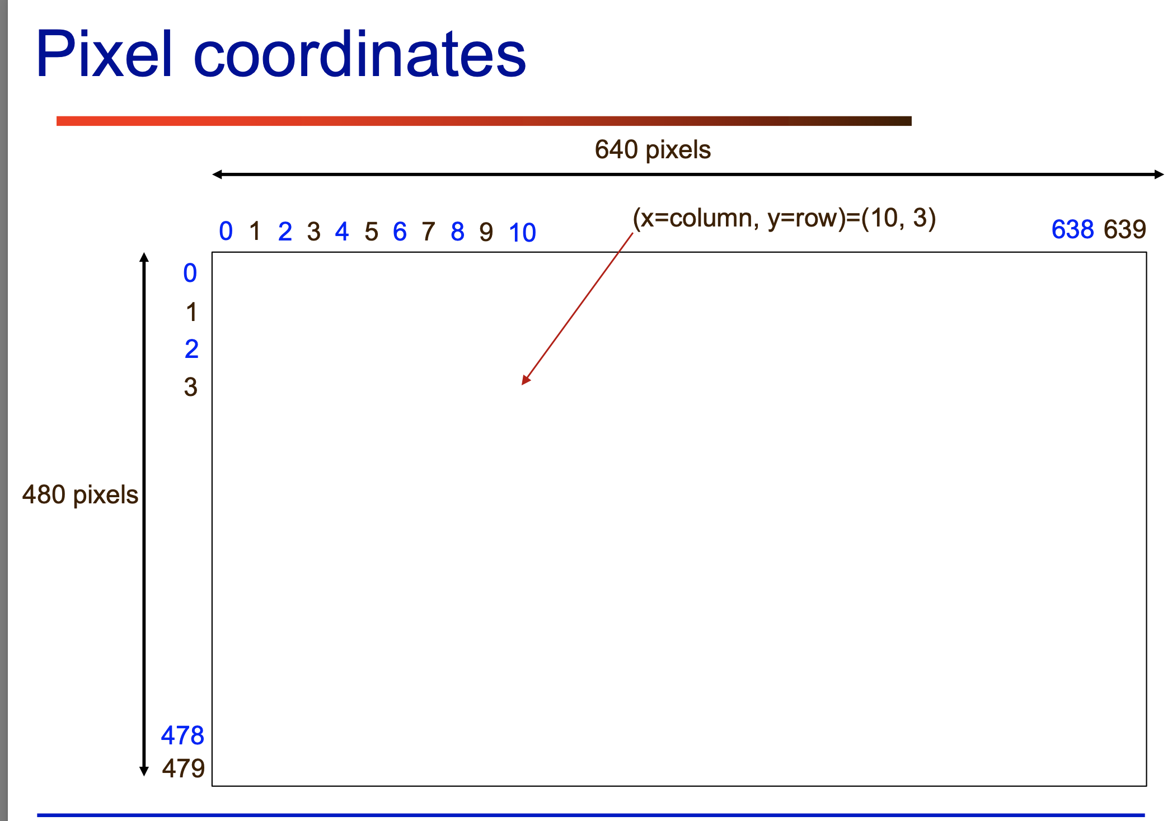

Slide 9
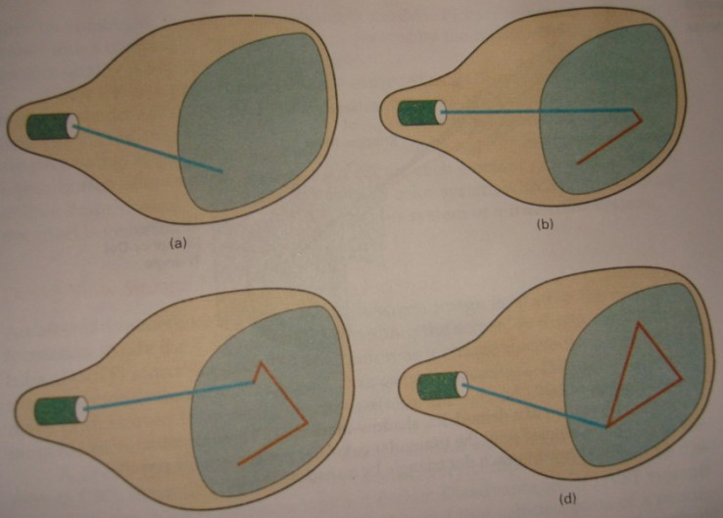
Random Scan Display
Electron beam is directed to the part of screen where picture is to be drawn
Picture definition is stored as set of line-drawing commands in memory are known as refresh display file or simply refresh buffer
Also known as Vector display
Prepared By: Dipesh Gautam

Slide 10
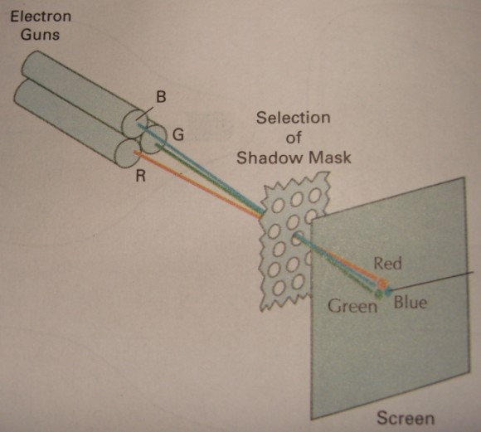
Color CRT Monitors
Uses combination of phosphors that emit different colored light (usually Red, Green and Blue)
Two basic methods for color picture display
  Beam penetration method
    Two layers of phosphor outer red layer and inner green layer
    slow electron strikes outer to produce red and faster strikes inner layer to produce green color while intermediate produces orange and yellow
    Only four colors are possible
  Shadow mask method
    Has three phosphor color dots (RGB) for each pixel position
    Three electron guns one for each color dot
    A shadow mask grid with holes aligned with the phosphor dot patterns
    Electron beams passed from a hole of shadow mask activate the phosphor dot pattern to display color picture
Prepared By: Dipesh Gautam

Slide 11
Architecture of Raster Scan System
Raster Scan Display basically employs a Cathode Ray Tube (CRT) or an LCD panel for display. The CRT works just like the picture tube of a television set. The Raster Scan Display viewing surface is coated with a layer of arrayed phosphor dots. At the back of the CRT is a set of electron guns (cathodes) that produce a controlled stream of electrons that says electron beam. The phosphor material emits light when struck by these high-energy electrons.

Slide 12
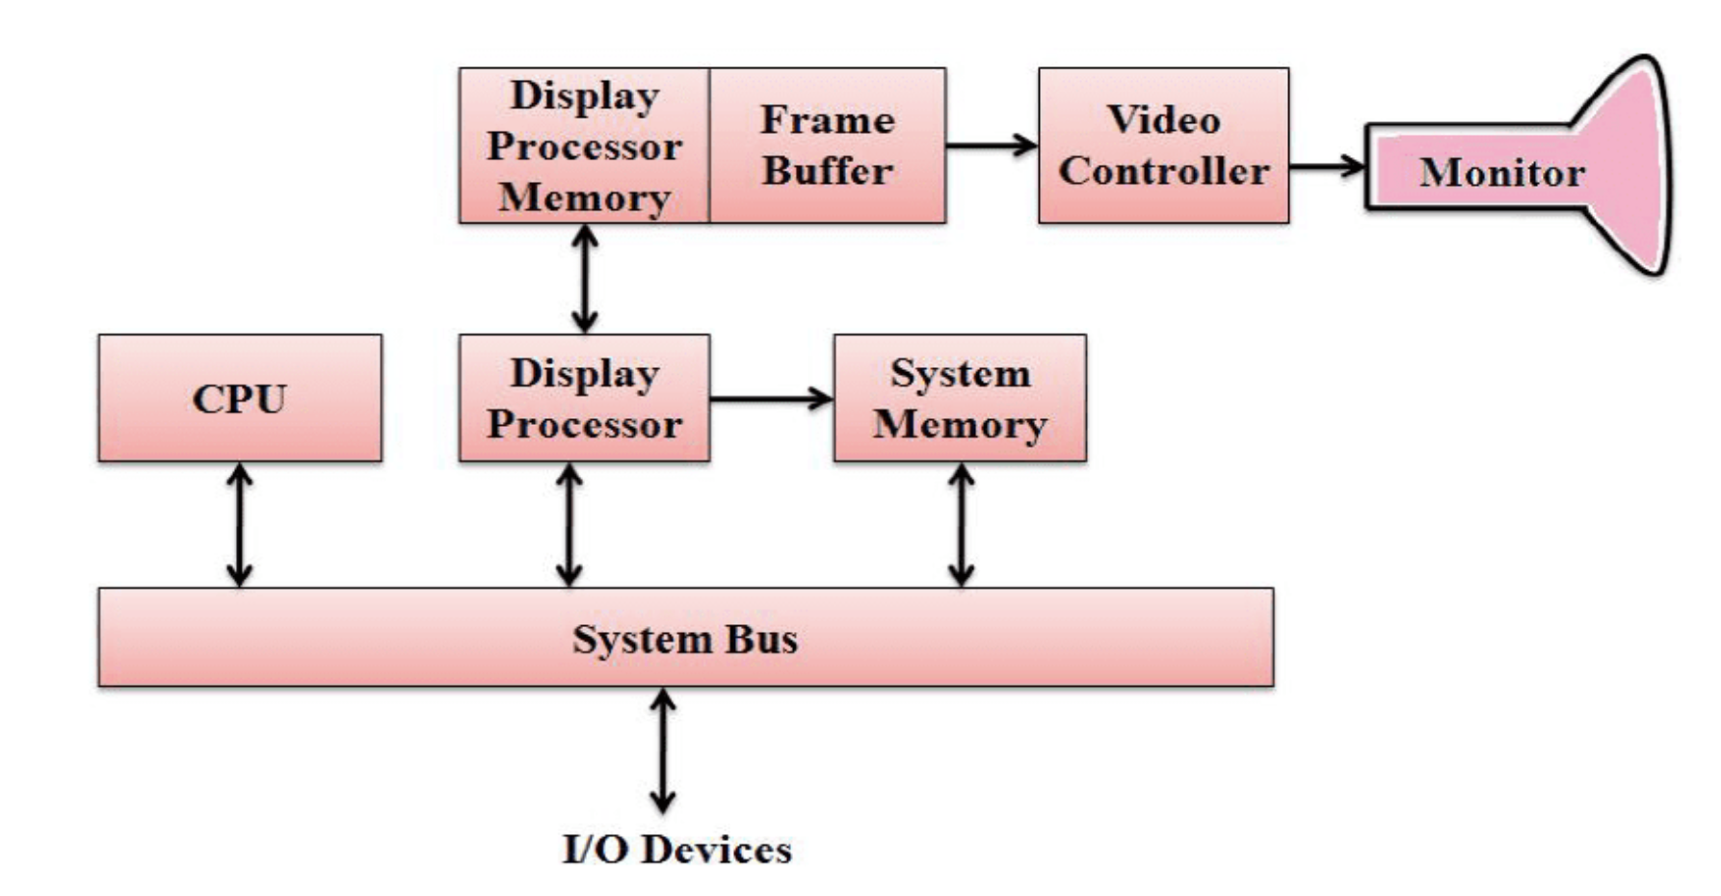

Slide 13
Architecture of Random Scan Display
In Random Scan Display, the electron beam is directed straightway to the particular points of the screen where the image is produced. Random Scan Display generates the image by drawing a set of random straight lines. It is much in the same way one might move a pencil over a piece of paper to draw an image. The drawing strikes from one point to another, one line at a time. That’s why this technique also says Vector Scan Display.

Slide 14
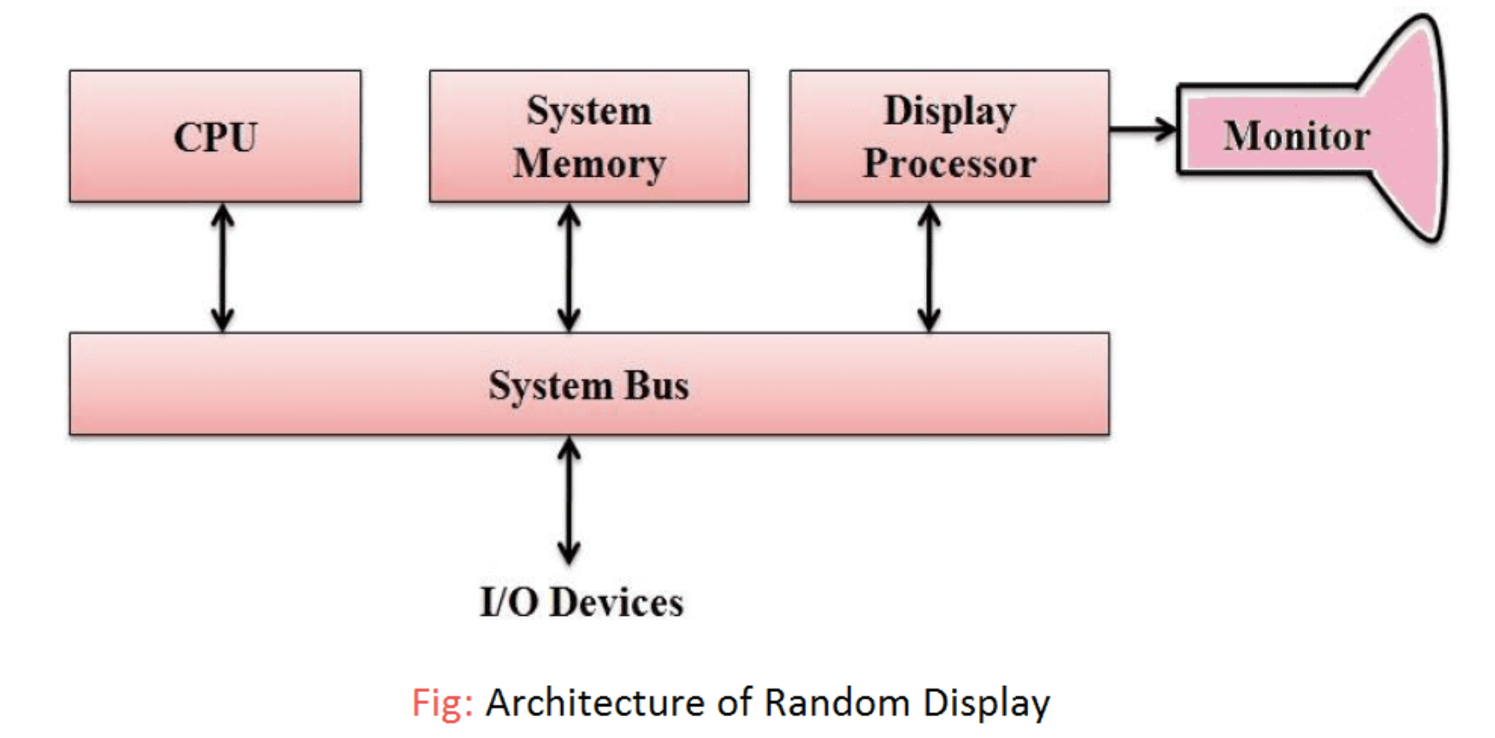

Slide 15
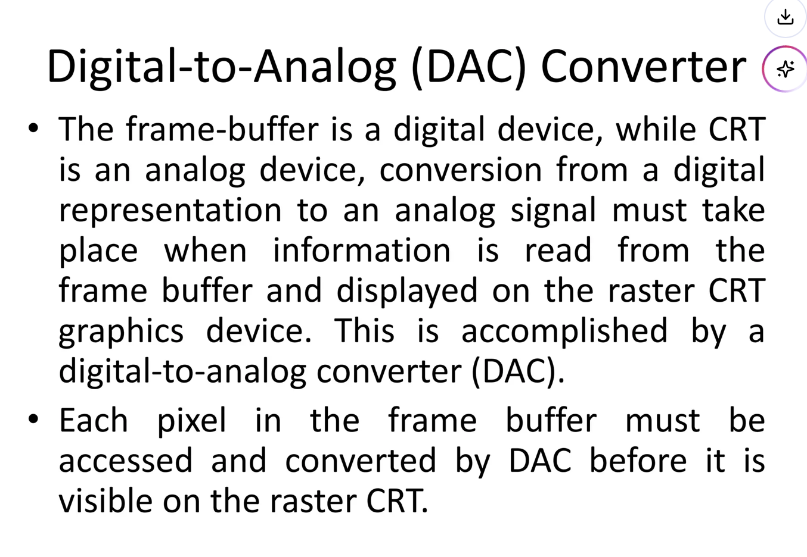

Slide 16
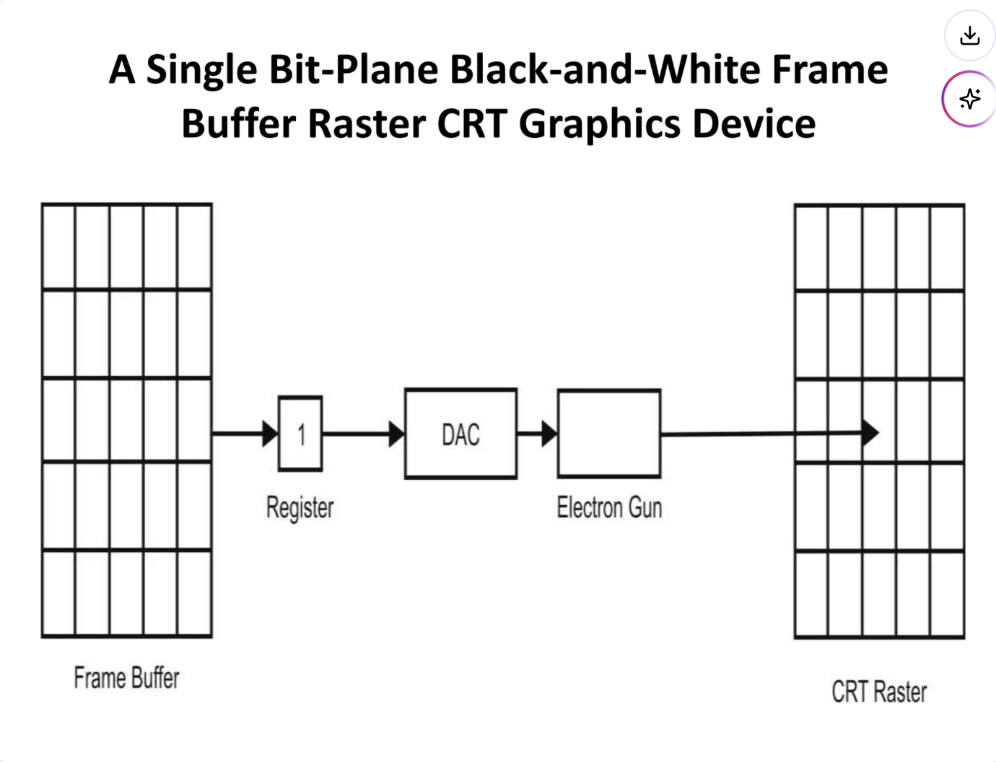

Slide 17
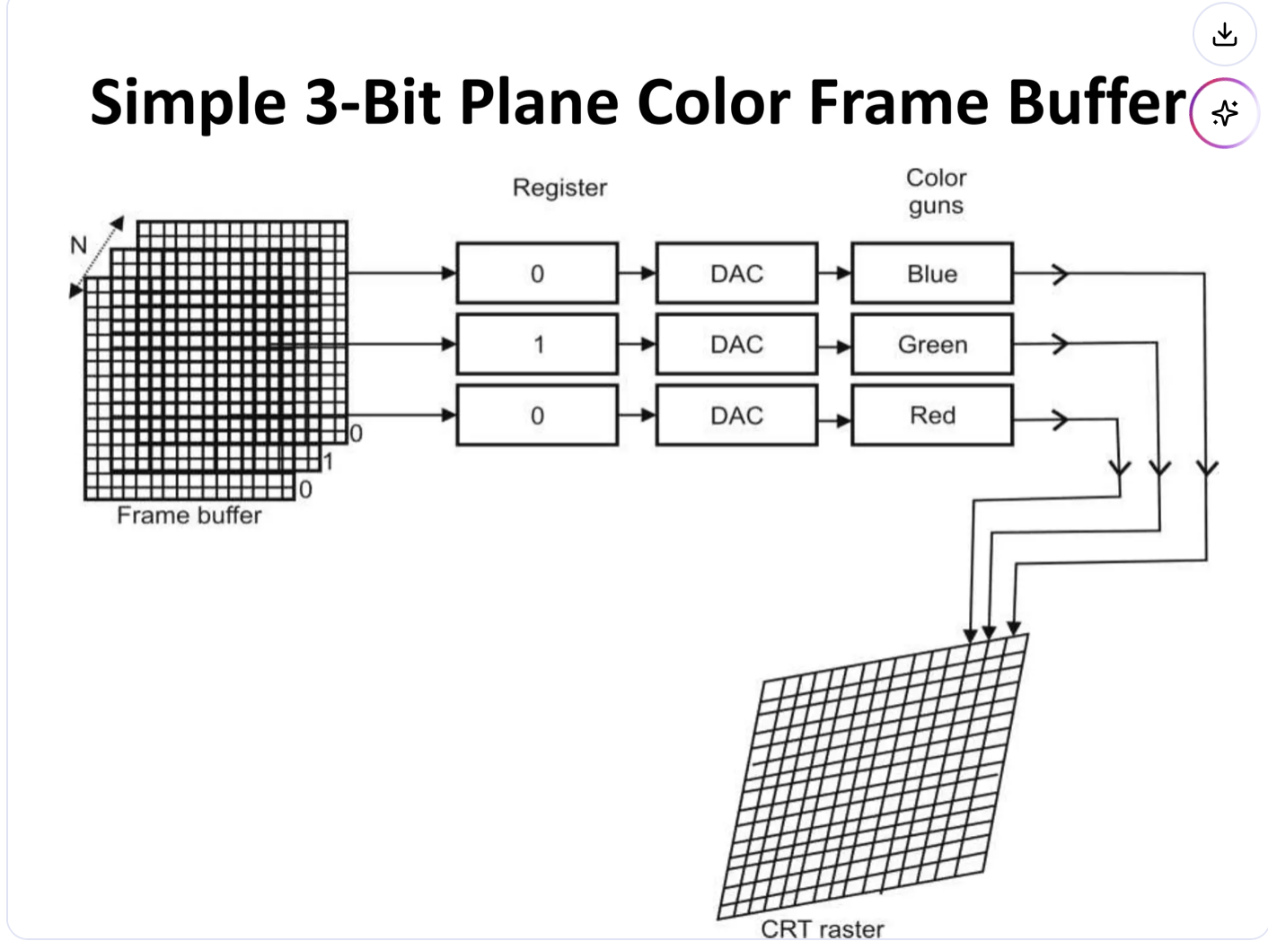

Slide 18
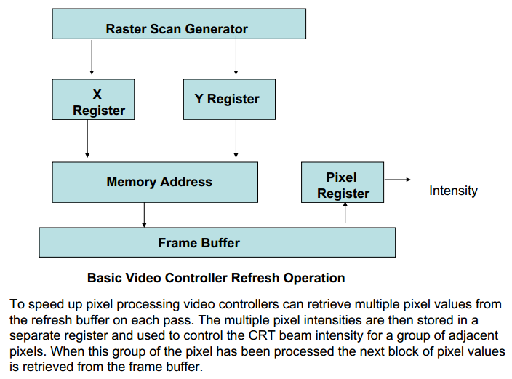
Video Controller

Slide 19


Fractal Geometry Method
Fractal geometry methods in computer graphics are used to model complex, irregular, and self-similar objects that traditional Euclidean geometry (points, lines, circles) cannot easily represent. These methods are foundational for generating realistic natural phenomena like mountains, clouds, coastlines, and vegetation.

Slide 20
3D Viewing Pipeline
Primitives
Object space
Modeling Transformation
World space
Viewing Transformation
Camera space
Hidden Surface Removal
Lighting & Shading
3D-Clipping
Projection
Normalized view space
Scan conversion, Hiding
Image space,
Device coordinates
January 9, 2026
Computer Graphics
Image

Slide 21
3D Clipping
Just like the case in two dimensions, clipping removes objects that will not be visible from the scene
The point of this is to remove computational effort
3-D clipping is achieved in two basic steps
  Discard objects that can’t be viewed
    i.e. objects that are behind the camera, outside the field of view, or too far away
  Clip objects that intersect with any clipping plane

Slide 22
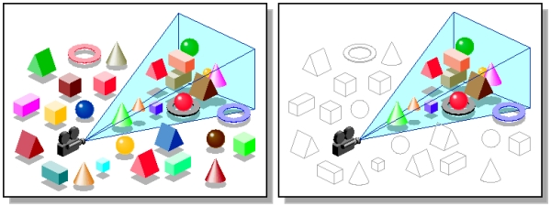
Discarding objects that cannot possibly be seen involves comparing an objects bounding box/sphere against the dimensions of the view volume
  Can be done before or after projection

Slide 23
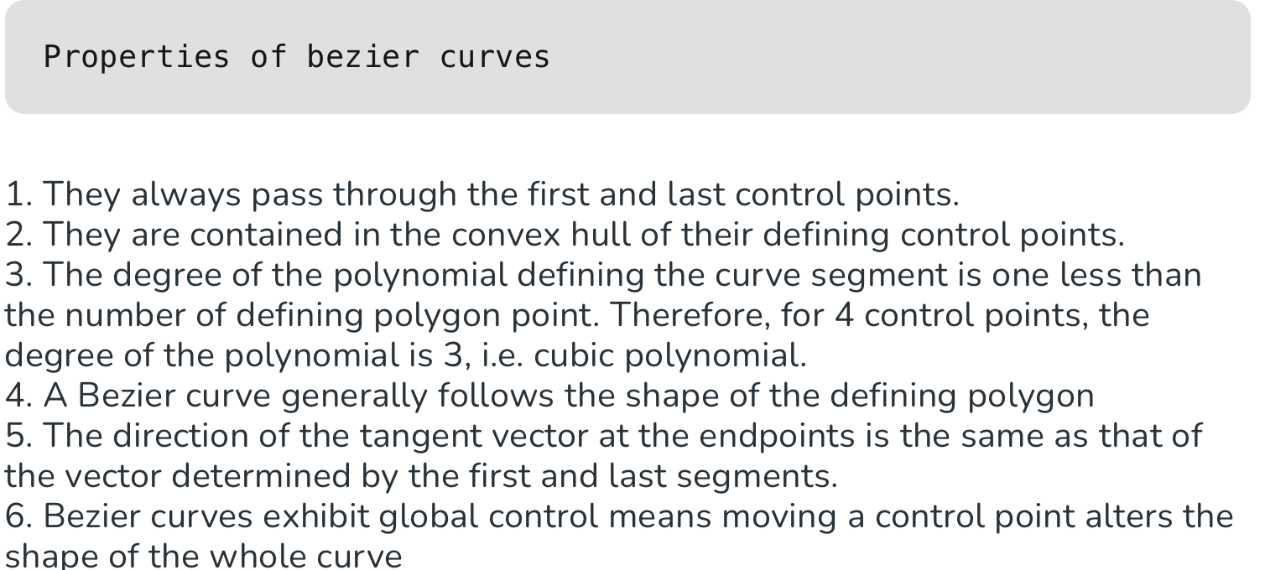

Slide 24
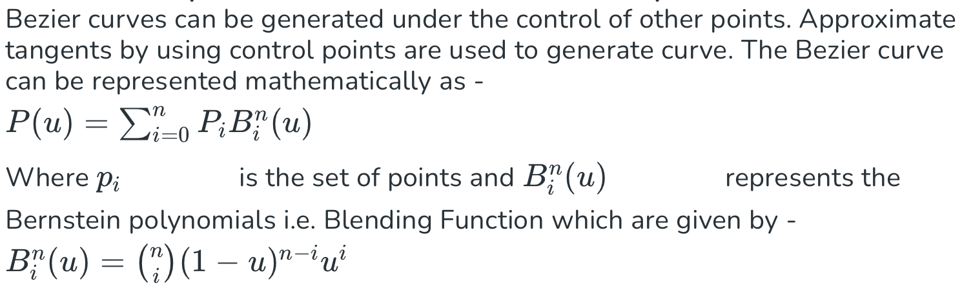
Bezier Curve

Slide 25
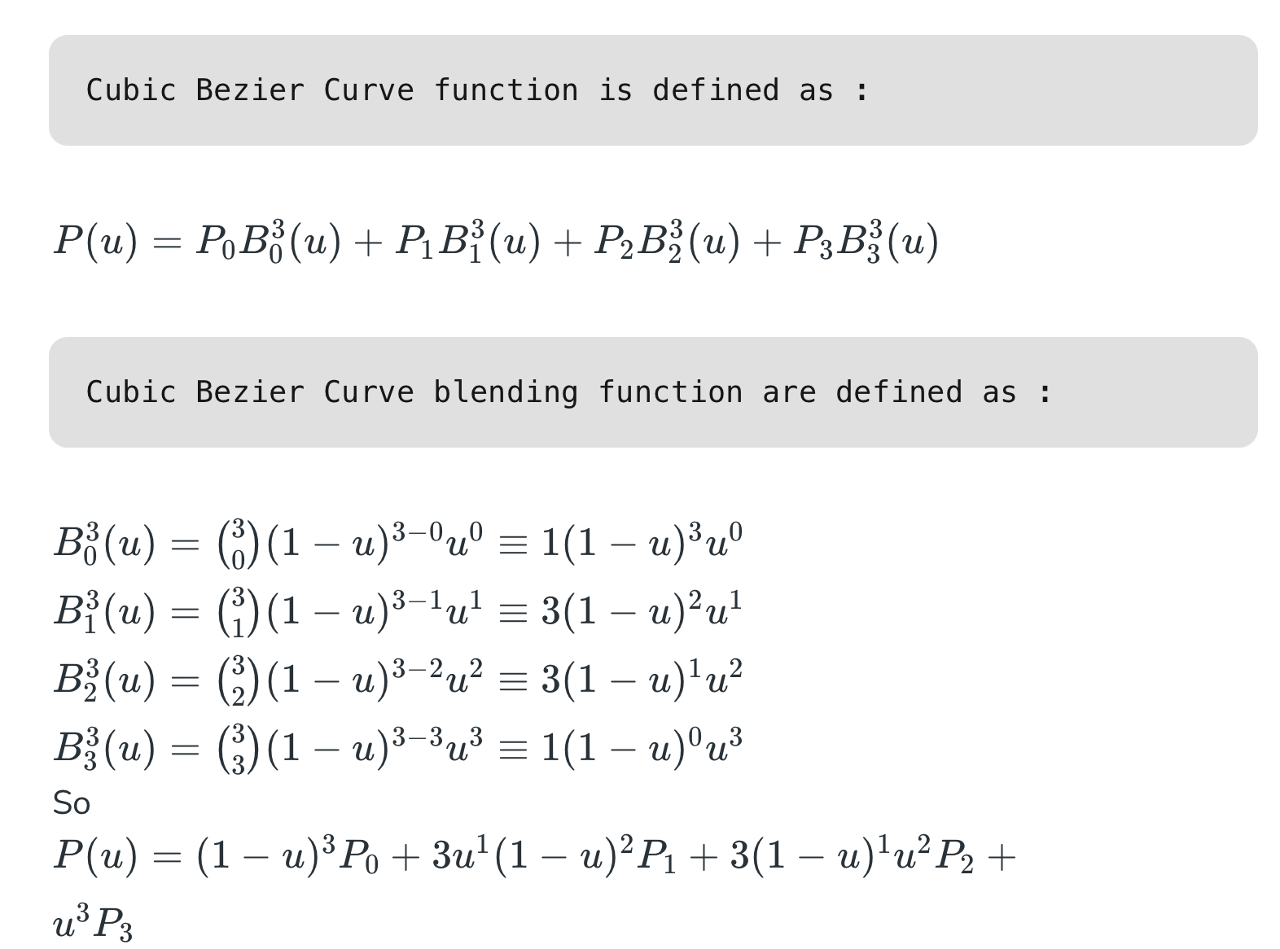

Slide 26
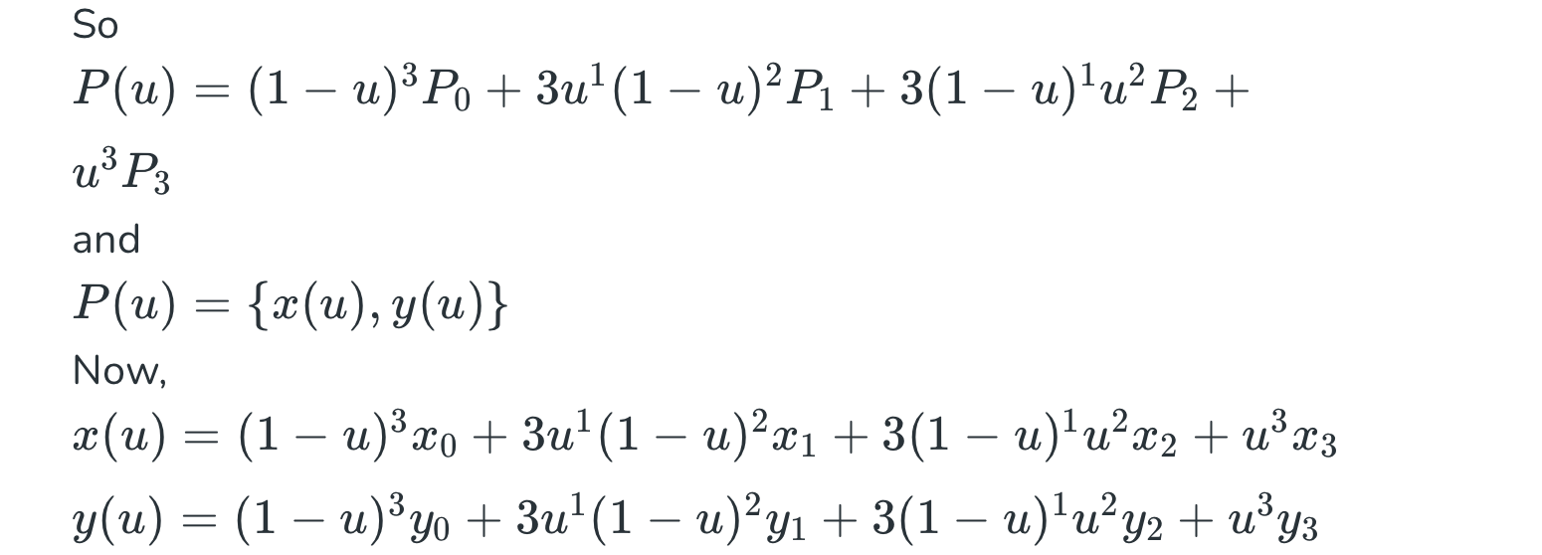

Slide 27
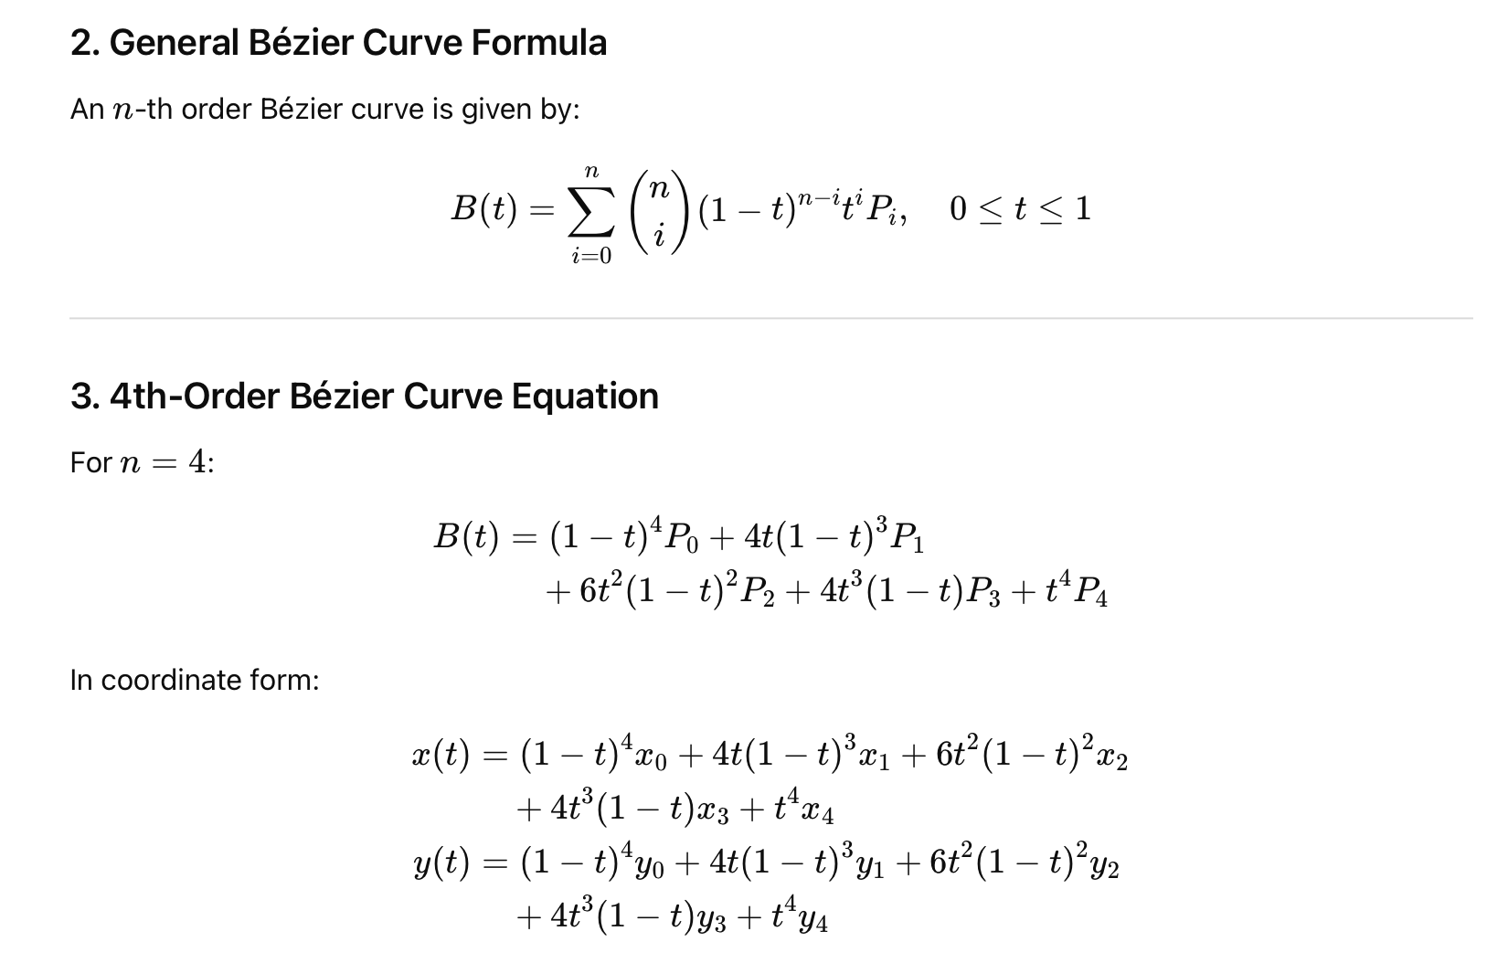
Fourth Order Bezier Curve

Slide 28

Example

Slide 29
